Slide 1
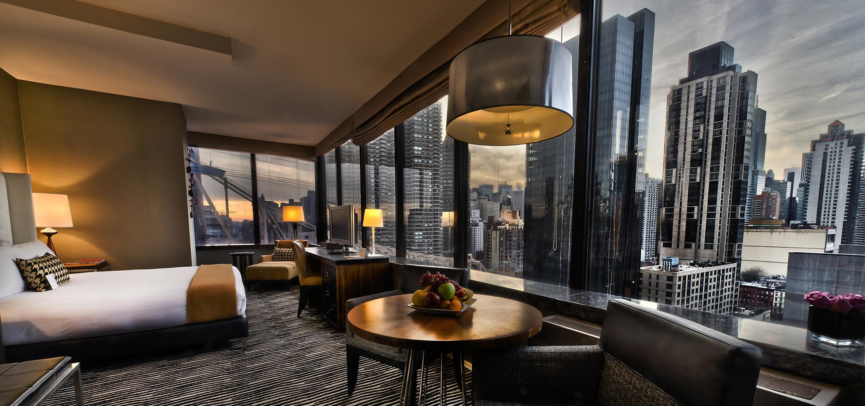
The Battle of Neighborhoods
Search for the Reality in picking up the right hotel……..
Shaik AbdulRahaman

Slide 2
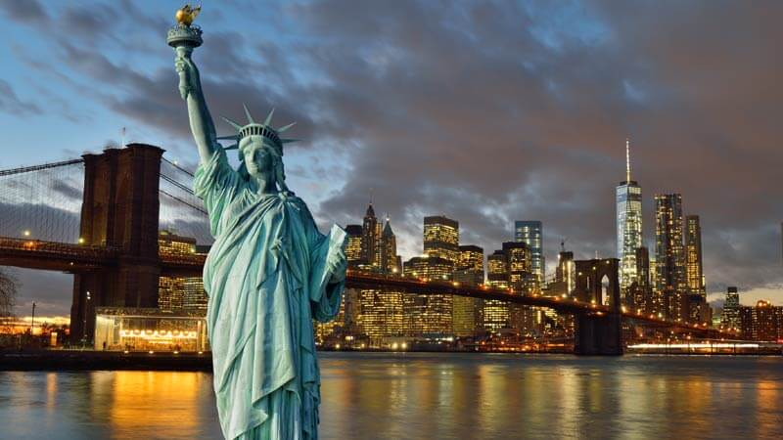
New York City
New York City - there's no place quite like it. Even if you think you know New York City well-the world-class museums, amazing food and unforgettable views-there's always something new and exciting to discover. Thrilling shows, fabulous shopping, and first-rate sports draw visitors from around the globe to the world's entertainment capital.With awesome architecture and parks, New York was rated No. 1 of America's most beautiful cities by Budget Travel. Take in its grandeur from observation decks at icons like the Empire State Building and Top of the Rock, or on a stroll across the Brooklyn Bridge or Brooklyn Heights Promenade.

Slide 3
Problem
To Pick the best hotel to stay in New York city and to find the surrounding venus so that the user can pick the best one based upon his choice.

Slide 4
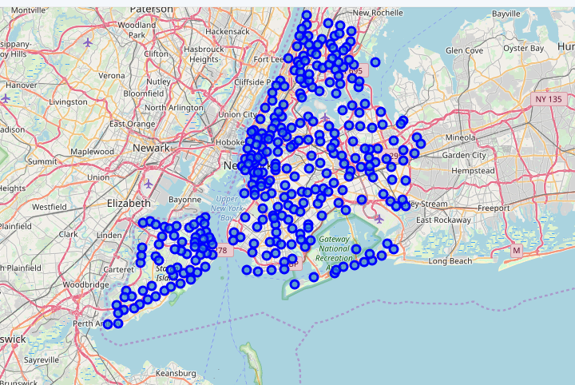
Stage-i
Finding the geographical coordinates of the NewYork city and marking all the neighborhoods on the map as shown.

Slide 5
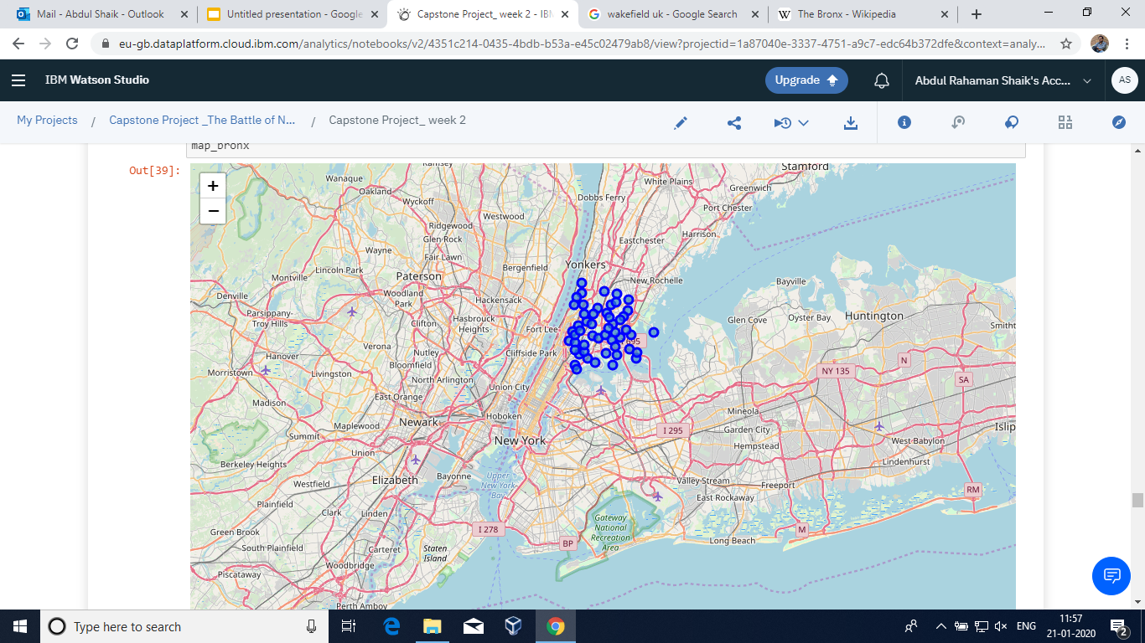
Stage-II
Considering Bronx as a required country in New York City and finding the geographical area and then finding the surroundings plotting on the map as shown

Slide 6
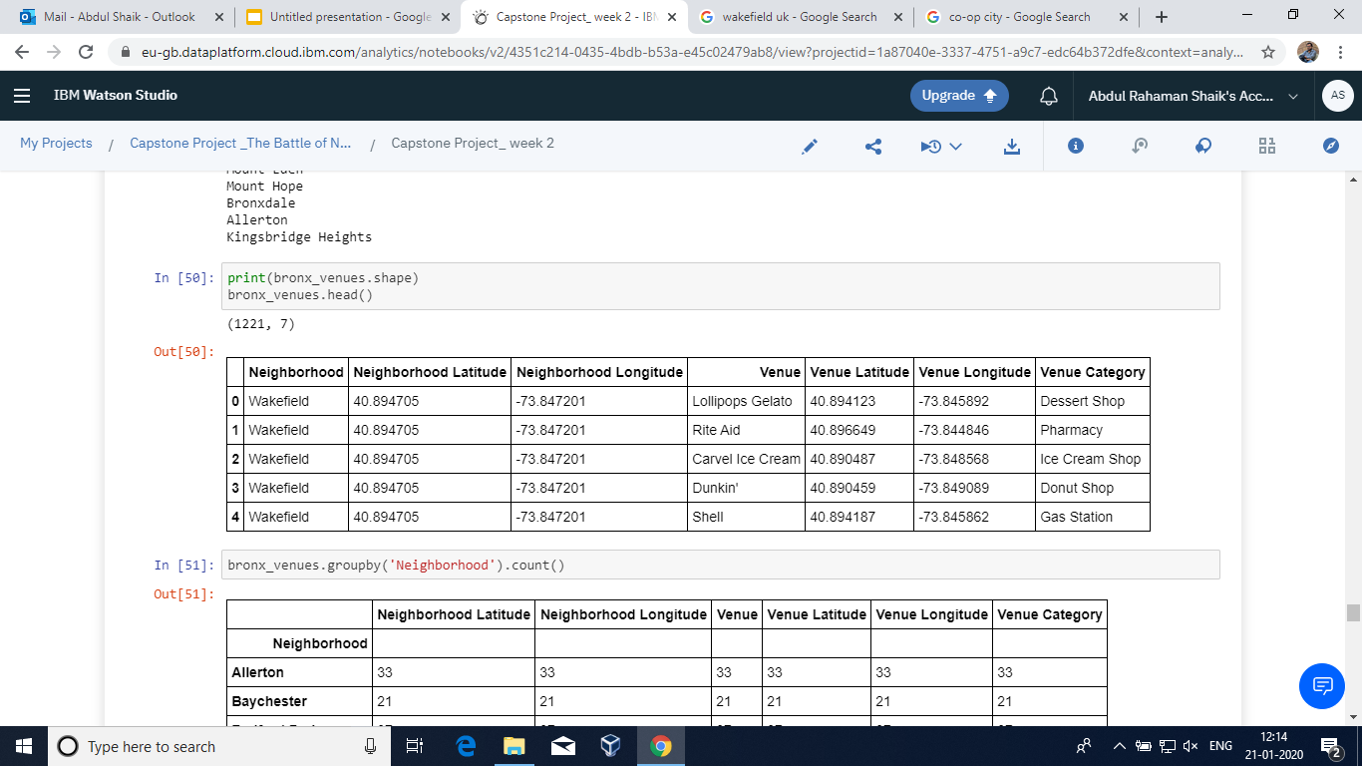
Stage-iii
Now Considering the Wakefield as the required city and then finding the latitude and longitude of that area and then fetching popular stores available in that area.

Slide 7
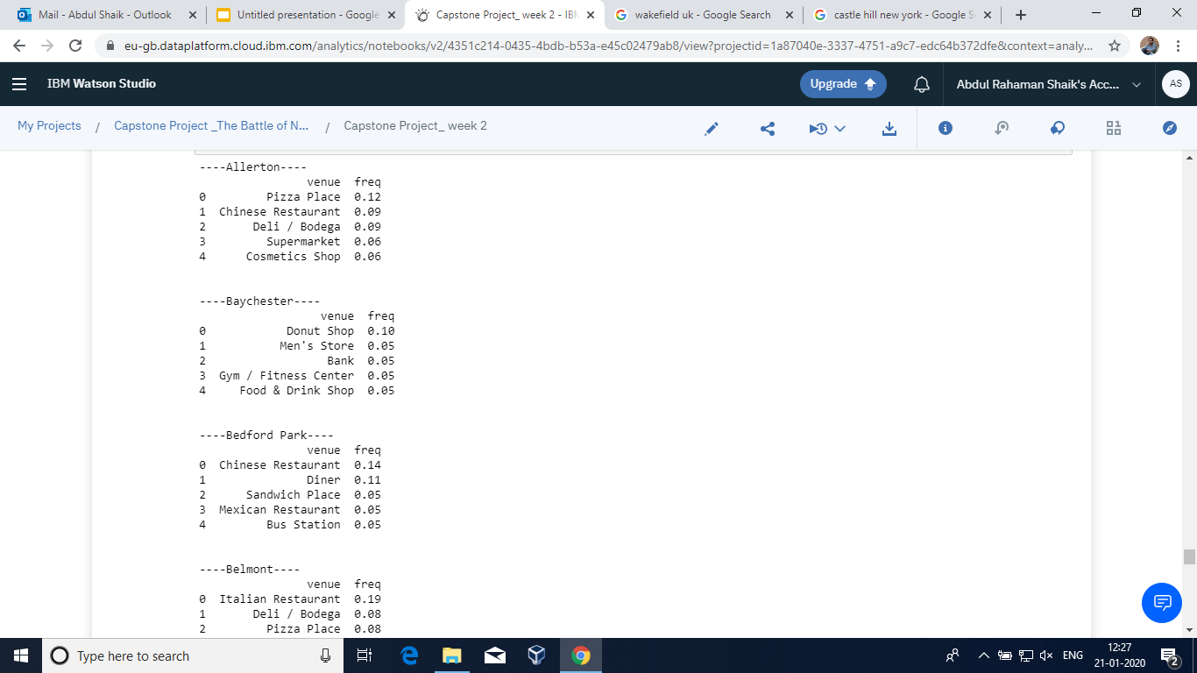
Stage-iv
Getting all the hotels along with the top 5 venus listed below to the hotels.

Slide 8
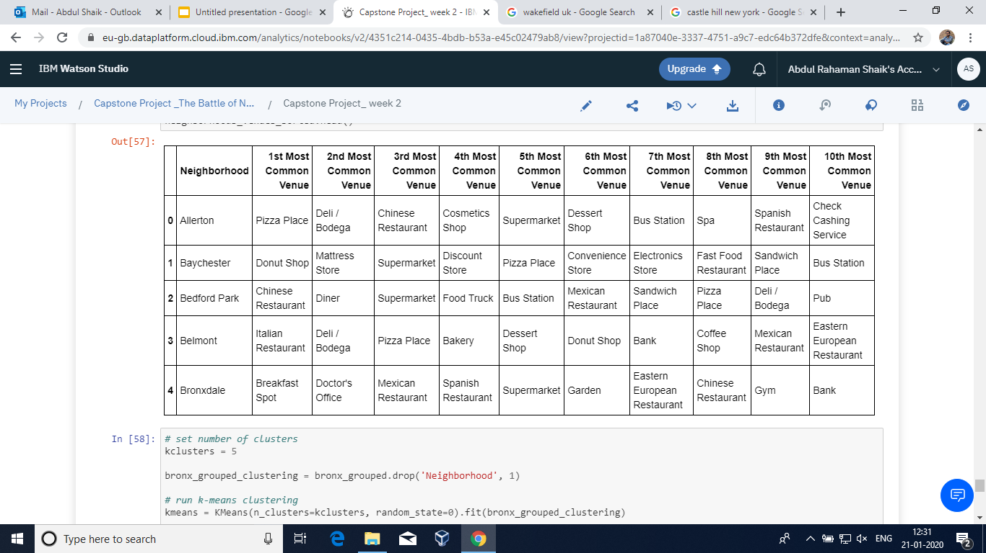
Stage-V
Finally getting the top picks along with the venus filtered on the priority bases and are tabulated for easy understanding

Slide 9
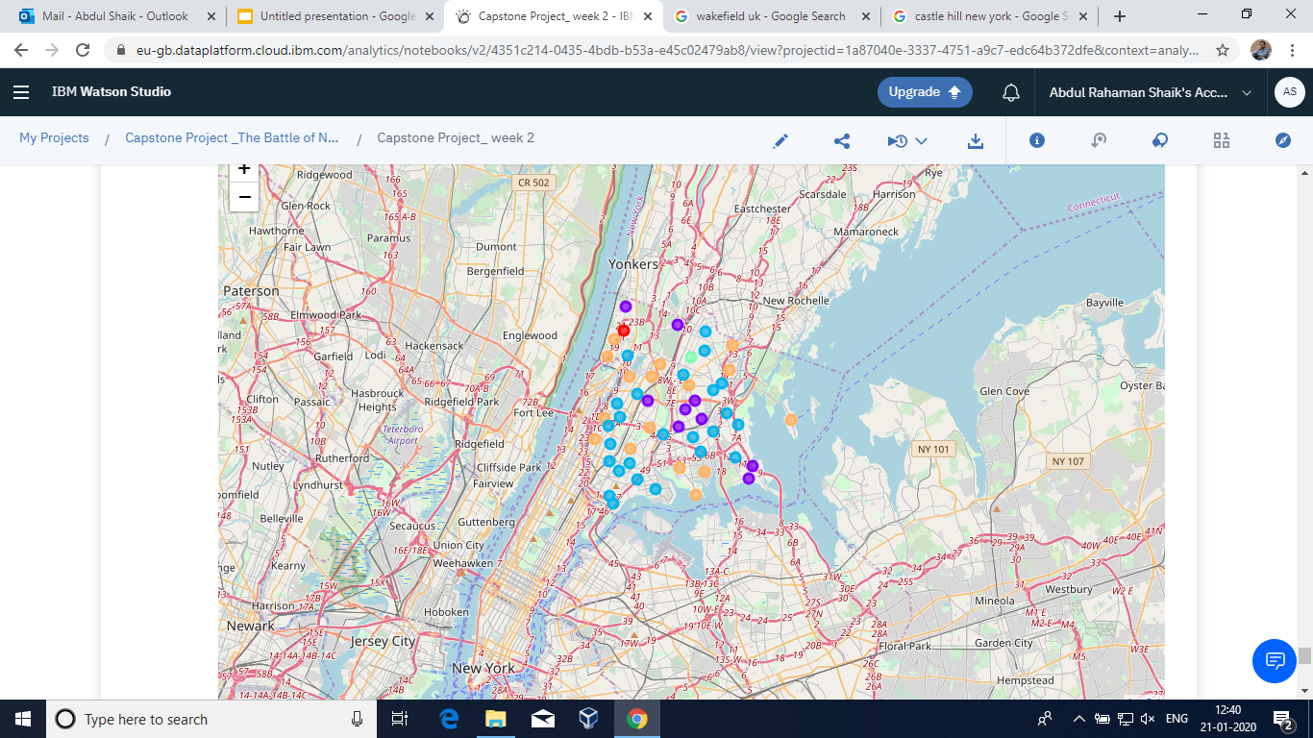
Satge-vi
Marking the venu along with the neighborhoods for selected hotel.

Slide 10
conclusion
Finally the users pick the best hotel to his required choice as he can be knowing the neighbour venus and the visiting places.
Thank You !!!

